Slide 1

Connecting Python with SQL Database

Slide 2
OBJECTIVE
To make student aware about Connectivity between frontend -backend

Slide 3
Point to be Focused
(3 Important Steps)
Download Python 3.5.3 and then install it
Download MySQL API, exe file will be
downloaded install it.
Install MySQL-Python Connector
Now connect MySQL Server using Python.

Slide 4

What is a Cursor
What is MySQLdb
What is Connection

Slide 5

What is MySQLdb
MySQLdb is an interface for connecting to a MySQL database server from Python.
It implements the Python Database API and is built on top of the MySQL C API.
Just type the following in your Python script and execute it −
#!/usr/bin/python
import MySQLdb

Slide 6

MySQLdb
import MySQldb

Slide 7
What is Connection
The next step to using MySQL in your Python scripts is to make a connection to the database that you wish to use. All Python DB-API modules implement a function
'module_name.connect‘
This is the function that is used to connect to the database, in our case MySQL..

Slide 8
Connection MySQLdb
Db=MySQLdb.connect (“localhost”, testuser”,
”test123”, ”TESTDB”)

Slide 9

Connecting to a MySQL database
:
db = MySQLdb.connect(host=MY_HOST, user=MY_USER, passwd=MY_PASS, db=MY_DB)
Your user name
Your Local host
Your Password
Name of the Database
db = MySQLdb.connect("localhost","testuser","test123","TESTDB" )

Slide 10
Create Cursor
cur=db.cursor()

Slide 11
The next step is to create a Cursor object.
It will let you execute all the queries you need
In order to put our new connnection to good use we need to create a cursor object.
The cursor object is an abstraction specified in the Python DB-API
It gives us the ability to have multiple seperate working environments through the same connection to the database.
We can create a cursor by executing the 'cursor' function of your database object.
What is Cursor

Slide 12

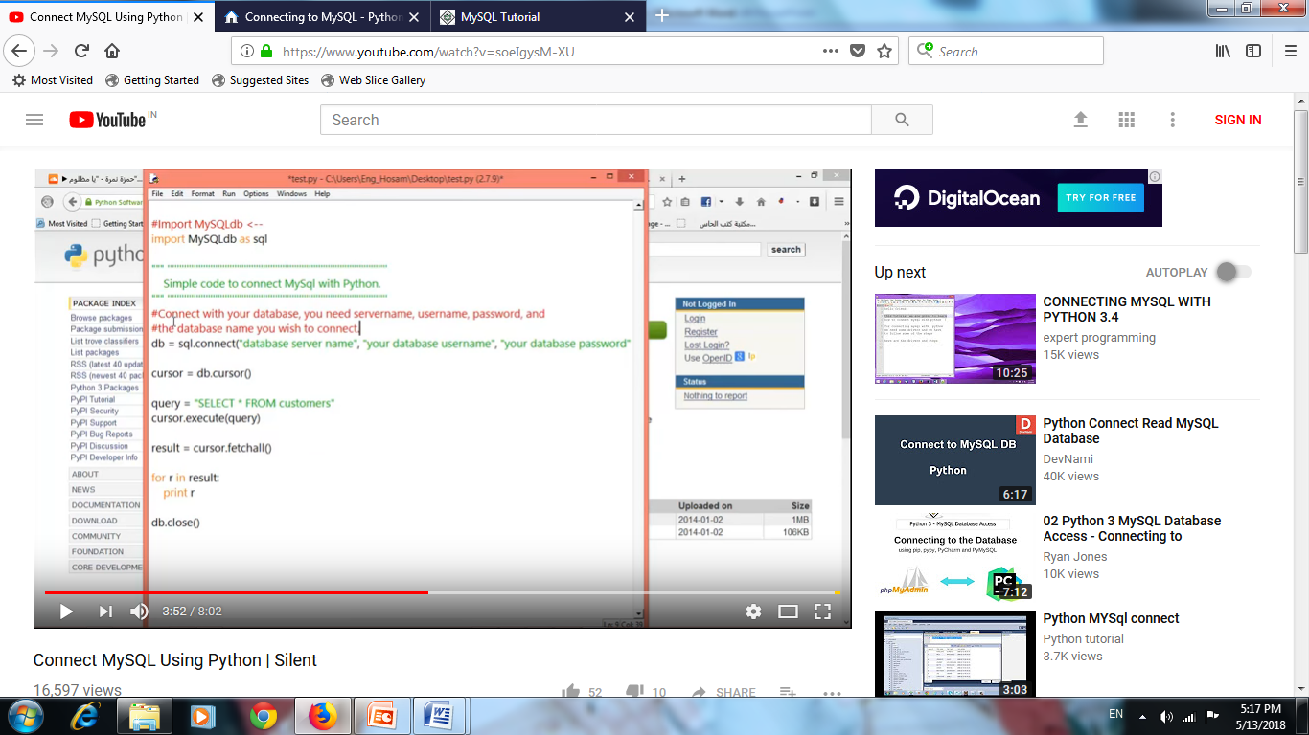
Example of Simple Code to Connect MySQL with Python
<? xml version=“1.0” ?>
<land>
<forest>
<Tree>
---------------------------
---------------------------
---------------------------
</Tree>
</forest>
</land>

Slide 13

Creating database Table
Once a Database Connection is established, we are ready to create tables using execute( ) method of the created cursor
Example
#!/usr/bin/python
import MySQLdb
# Open database connection
db = MySQLdb.connect("localhost","testuser","test123","TESTDB" )
# prepare a cursor object using cursor() method
cursor = db.cursor()
# Drop table if it already exist using execute() method.
cursor.execute("DROP TABLE IF EXISTS EMPLOYEE")
# Create table as per requirement
sql = “ “ "CREATE TABLE EMPLOYEE (FIRST_NAME CHAR(20) NOT NULL,
LAST_NAME CHAR(20),
AGE INT,
SEX CHAR(1),
INCOME FLOAT )“ “ "
cursor.execute(sql)
# disconnect from server
db.close()

Slide 14
Insert Records into databse table
Its required to insert records in table for fetching records.
Example
#!/usr/bin/python
import MySQLdb
# Open database connection
db = MySQLdb.connect("localhost","testuser","test123","TESTDB" )
# prepare a cursor object using cursor() method
cursor = db.cursor()
# Prepare SQL query to INSERT a record into the database.
sql = """INSERT INTO EMPLOYEE(FIRST_NAME,LAST_NAME, AGE, SEX, INCOME)
VALUES('Mac', 'Mohan', 20, 'M', 2000)"""
try:
# Execute the SQL command
cursor.execute(sql)
# Commit your changes in the database
db.commit()
except:
# Rollback in case there is any error
db.rollback()
# disconnect from server
db.close()

Slide 15
Read Records (Select) into databse table
Read operation on any database means to fetch some useful information from the database.
We can use fetchone() method to fetch single record
fetchall() method to fetch multiple values from a database table.
fetchone() − It fetches the next row of a query result set.
A result set is an object that is returned when a
cursor object is used to query a table.
fetchall() − It fetches all the rows in a result set.
If some rows have already been extracted from the
result set, then it retrieves the remaining rows from the
result set.
rowcount − This is a read-only attribute and returns the number of rows that were affected by an execute() method.

Slide 16
Example
import MySQLdb
db = MySQLdb.connect("localhost","testuser","test123","TESTDB" )
cursor = db.cursor()
sql = "SELECT * FROM EMPLOYEE WHERE INCOME > '%d'" % (1000)
try:
cursor.execute(sql)
# Fetch all the rows in a list of lists.
results = cursor.fetchall()
for row in results:
fname = row[0] lname = row[1]
age = row[2] sex = row[3]
income = row[4]
# Now print fetched result
print "fname=%s,lname=%s,age=%d,sex=%s,income=%d" %
(fname, lname, age, sex, income )
except:
print "Error: unable to fecth data"
# disconnect from server
db.close()

Slide 17
Update information into databse table
UPDATE Operation on any database means to update one or more records, which are already available in the database.
The following procedure updates all the records having SEX as 'M'. Here, we increase AGE of all the males by one year.
Example
import MySQLdb
db = MySQLdb.connect("localhost","testuser","test123","TESTDB" )
cursor = db.cursor()
sql = "UPDATE EMPLOYEE SET AGE = AGE + 1 WHERE SEX = '%c'" % ('M')
try:
cursor.execute(sql)
db.commit()
except:
db.rollback()
db.close()

Slide 18
Delete information into databse table
DELETE operation is required when you want to delete some records from your database. Following is the procedure to delete all the records from EMPLOYEE where AGE is more than 20
Example
import MySQLdb
db = MySQLdb.connect("localhost","testuser","test123","TESTDB" )
cursor = db.cursor()
sql = "DELETE FROM EMPLOYEE WHERE AGE > '%d'" % (20)
try:
cursor.execute(sql)
db.commit()
except:
db.rollback()
db.close()

Slide 19

To disconnect Database connection, use close() method.
db.close()
Disconnecting Database

